Slide 1
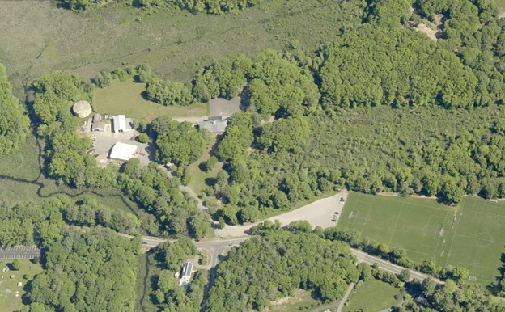
Iron Rail Property
Highest and Best Use Study
Public Meeting
August 16, 2023
Iron Rail Property / 91 Grapevine Road
MassDOT Pictometry

Slide 2
THE PROJECT TEAM
Peter
Helena
Eli
Jack
Dillon
Nate
Dodson & Flinker
Core Role
Community Engagement
Site Analysis and Assessment
Mapping and Graphics
Scenario Visioning
Key Staff
Peter Flinker, Helena Farrell, Eli Bloch, Jack Sweeney-Taylor, Dillon Sussman, Nate Burgess
Town of Wenham
Core Role
Municipal Coordination
Public Outreach and Participation
Stakeholder Input and Visioning
Key Staff
Joseph Pessimato, Assistant Town Administrator
Kate Mallory, Conservation & Open Space Coordinator
Margaret Hoffman,
Michelle McGovern,
Steve Poulos,

Slide 3
MEETING AGENDA
Introductions
Phase 1 Summation - what we learned from the 128 District Concept Plan and Report
Phase 2 Scope - How we translate the recommendations in phase 1 into new zoning and a primer on the FBC method
Project Schedule and Role of the Advisory Group
Goals for the 128 District - Advisory Group input on individual and collective goals for the district
Time | Discussion Topic
6:00PM | Welcome and Introductions. Overview of the project goals, project team, and scope of work.
6:10PM | Presentation of existing conditions. Discuss preliminary findings of demographic and market research.
7:00PM | Site strengths, challenges, and future opportunities. Identify additional information needed to make good decisions about the site and its future potential.
7:30PM | Community needs, values, and goals. Future uses and programming to be explored.
8:00PM | End

Slide 4
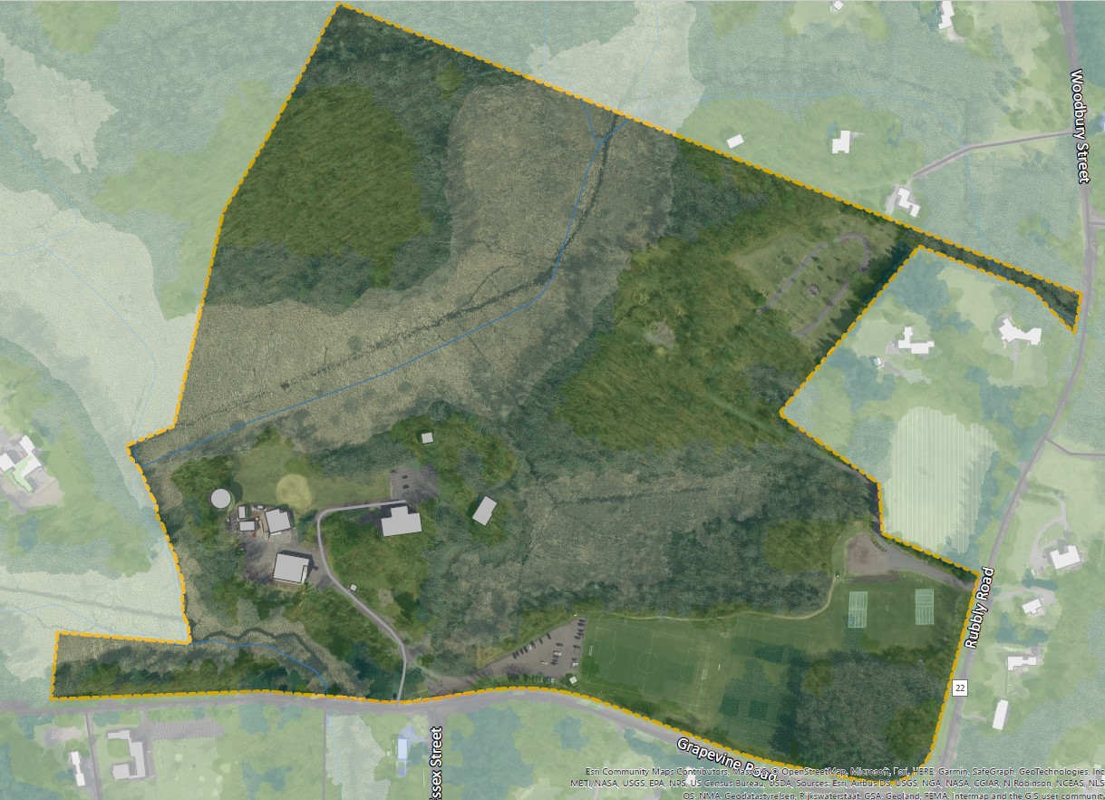
INTRODUCTION TO THE PROJECT
Iron Rail Property Overview
Purchased by the Town in 1976
Iron Rail Commission coordinates use and maintenance
Current use:
Department of Public Works headquarters
Water Department storage facility
Cemetery Commission – new cemetery
3 soccer fields
4 businesses in the Iron Rail Building
Boy Scout barn with kitchen and bathroom facilities
Conservation land with public access to roads and trails, including overnight camping
Notes:
New cemetery includes access road
Soccer fields utilized by:
Hamilton-Wenham Youth Soccer Association - 10-year lease ends in 2024 Landmark School - annual field use agreement offering limited use with rent paid to the Town, assisting with maintenance The Academy of Peguin Hall - annual field use agreement offering limited use with rent paid to the Town
Iron Rail Building tenants – leases expiring this year
Boy Scout barn is 40’x40’
Utilized by Scout Troop 28; Sutro Band and Wenham Football League; and open to residents at other times

Slide 5
INTRODUCTION TO THE PROJECT
Project Goal:
Evaluate the characteristics of the site and examine potential best use concepts to achieve the community’s vision and goals.

Slide 6
THE PROCESS
Public Engagement Public Meetings and Collaboration with Community Stakeholders
Facilitate shared fact-finding and discussion of community goals and values
Existing Conditions and Market Analysis Site Analysis Assess physical conditions, historic uses, regulatory constraints, market conditions, design considerations, and mobility needs
Opportunities, Challenges, & Best Use Alternatives Based on public input and analysis, identify and assess development opportunities and key alternatives
Iron Rail Property Highest & Best Use
Public Engagement
Analysis
Design Scenarios
Design Scenarios Three (3) Concept Plans Present and evaluate scenarios to identify the highest and best reuse of the site, based on input from the community and project team
Final Plan A final illustrated and annotated plan that describes the selected design scenario

Slide 7
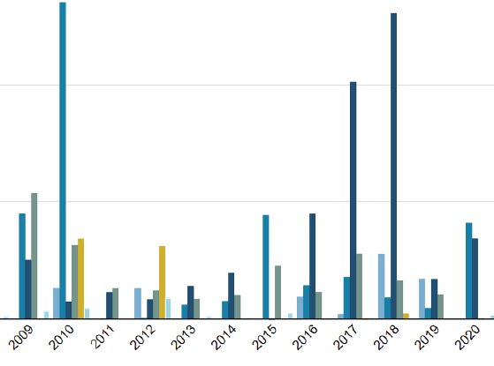
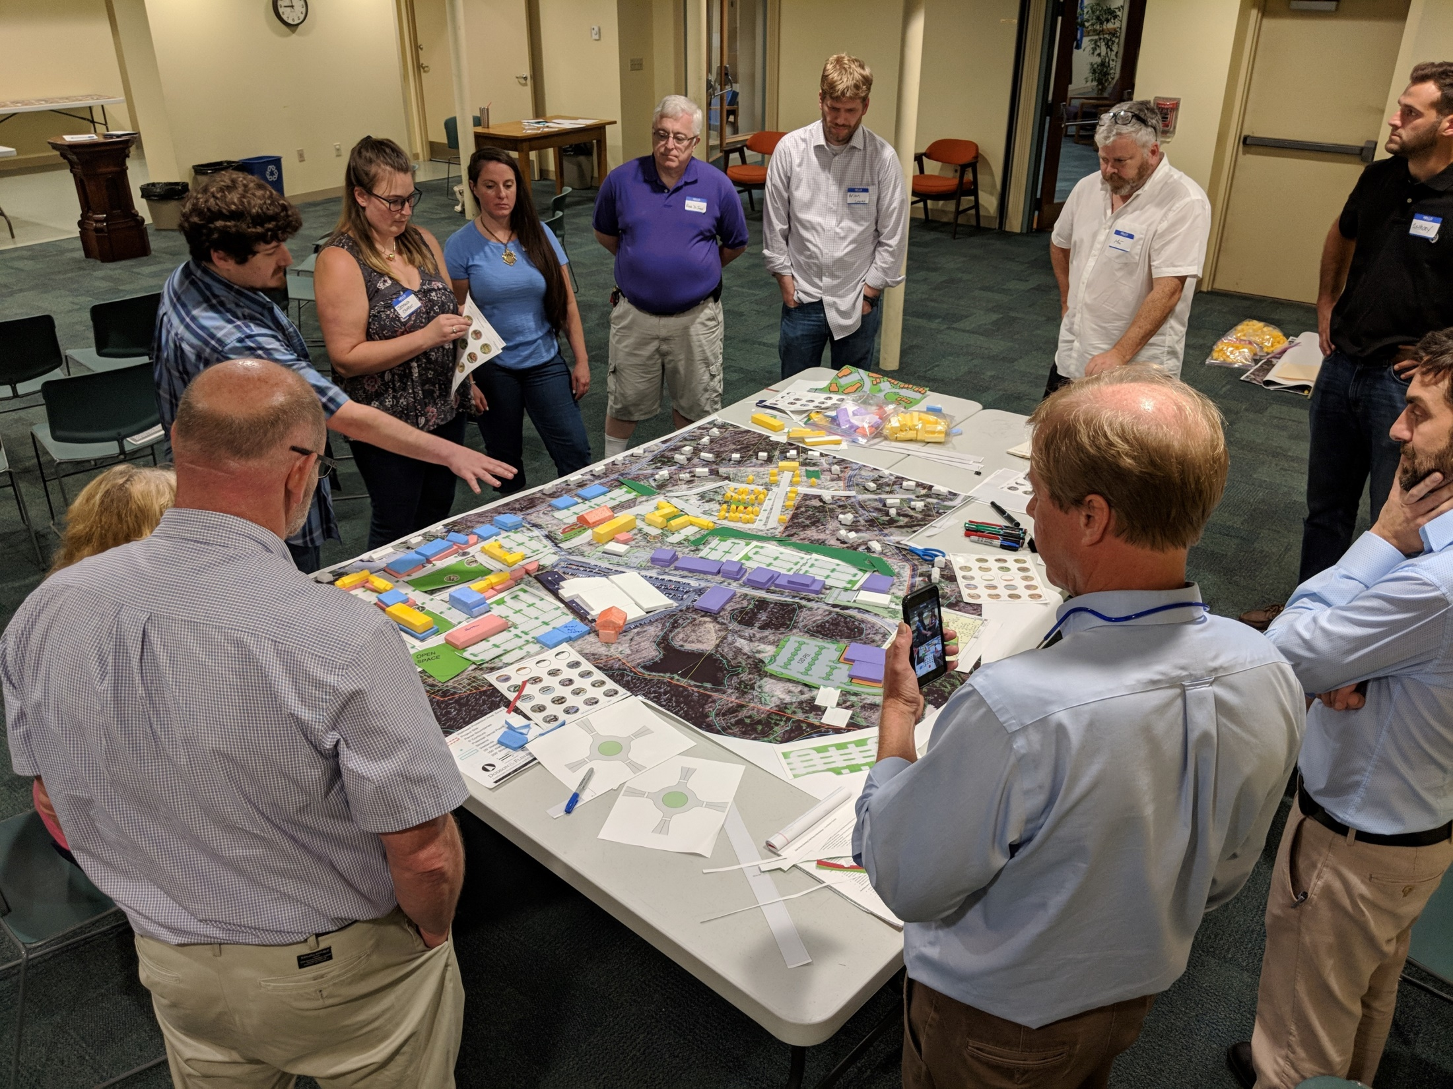
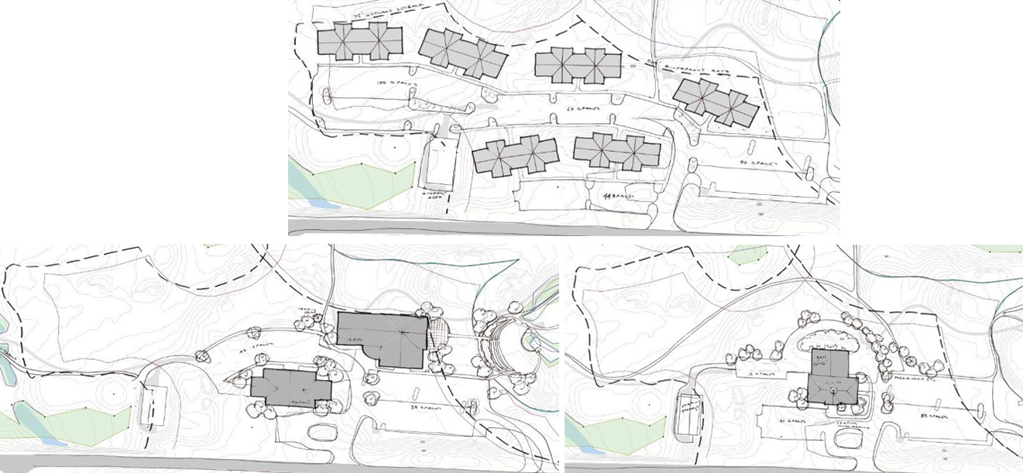
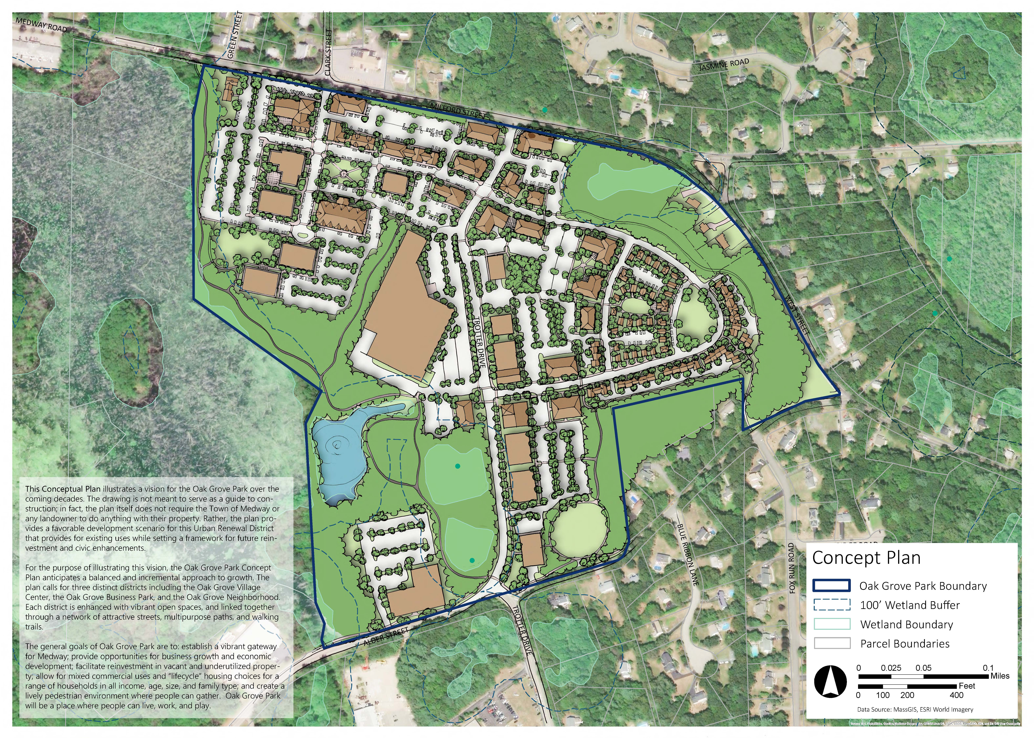
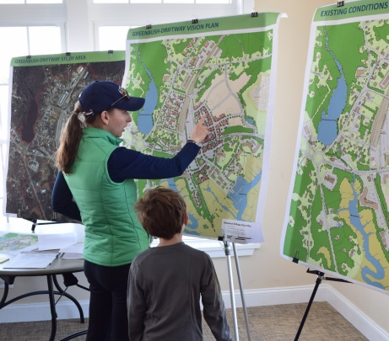
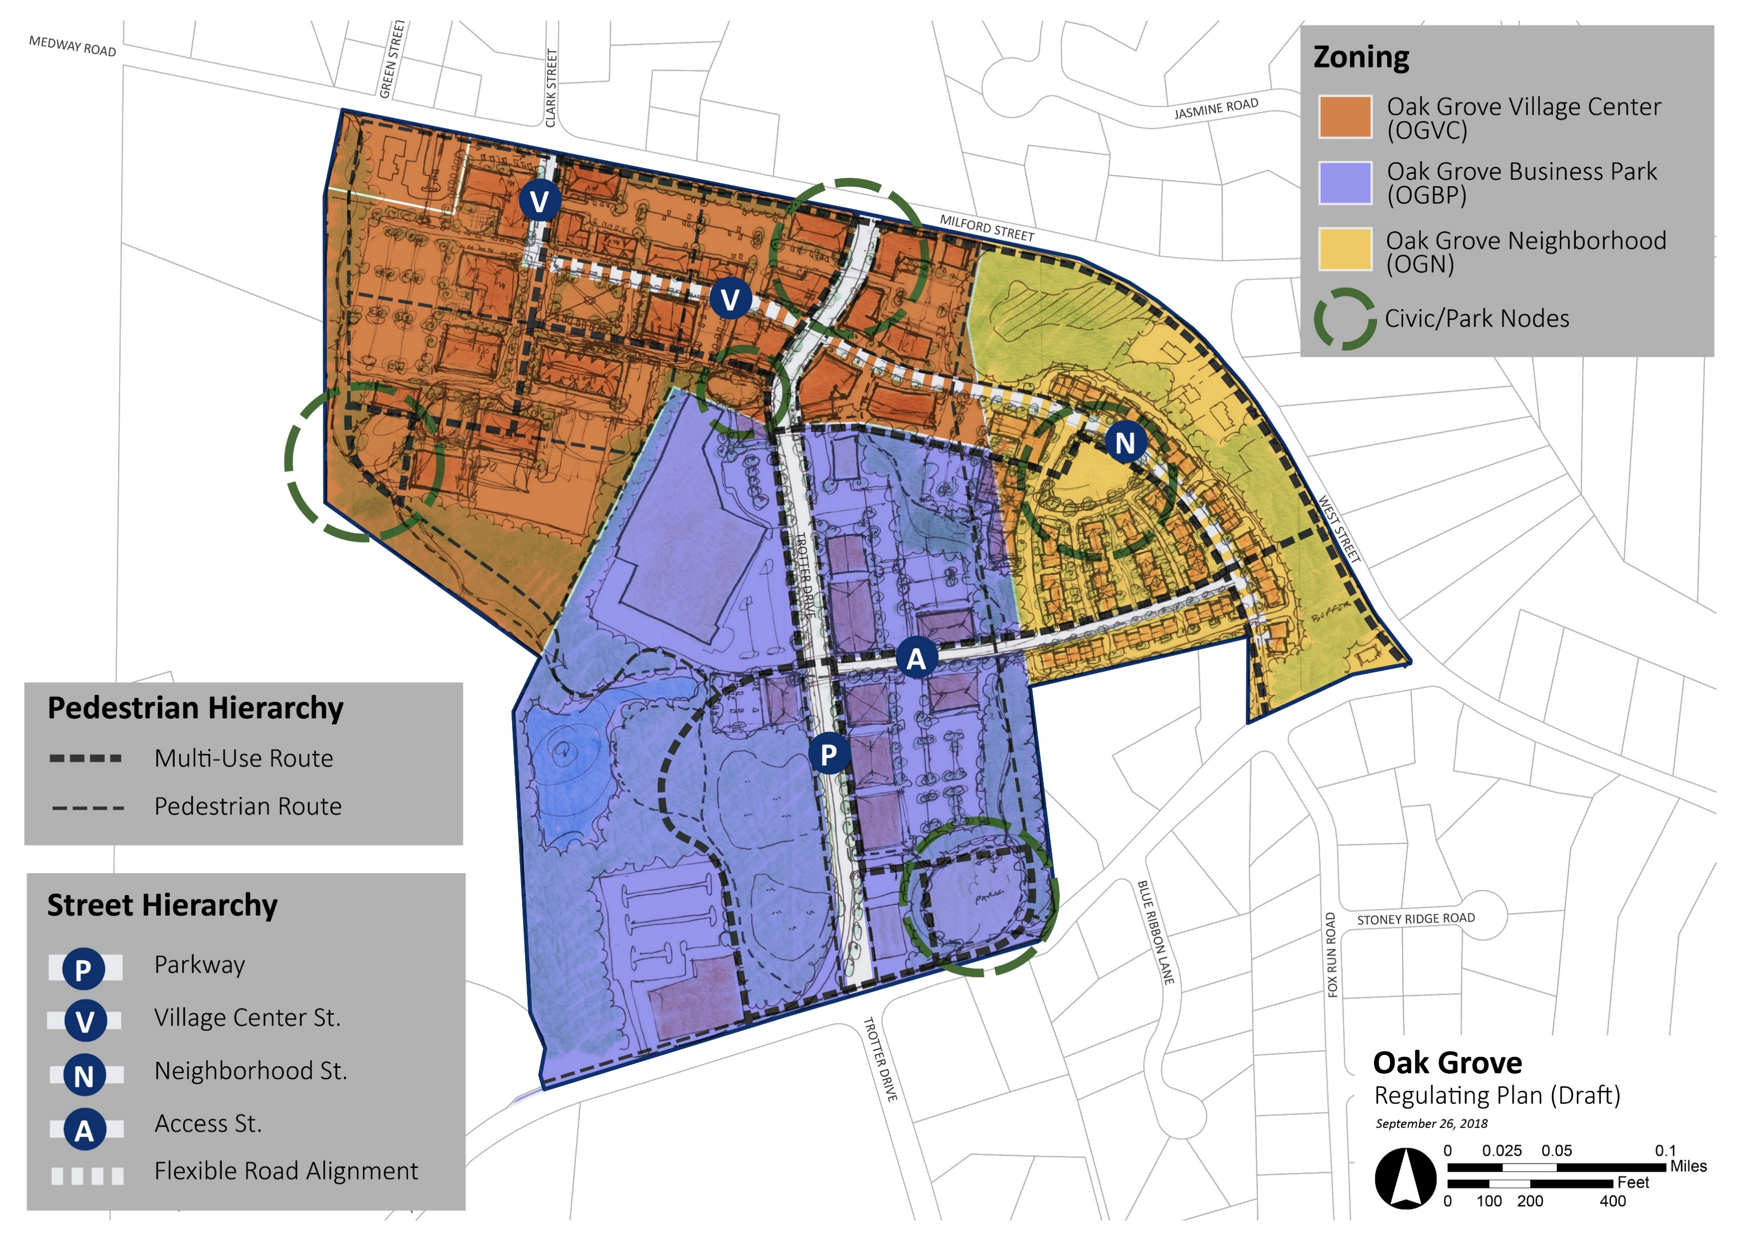
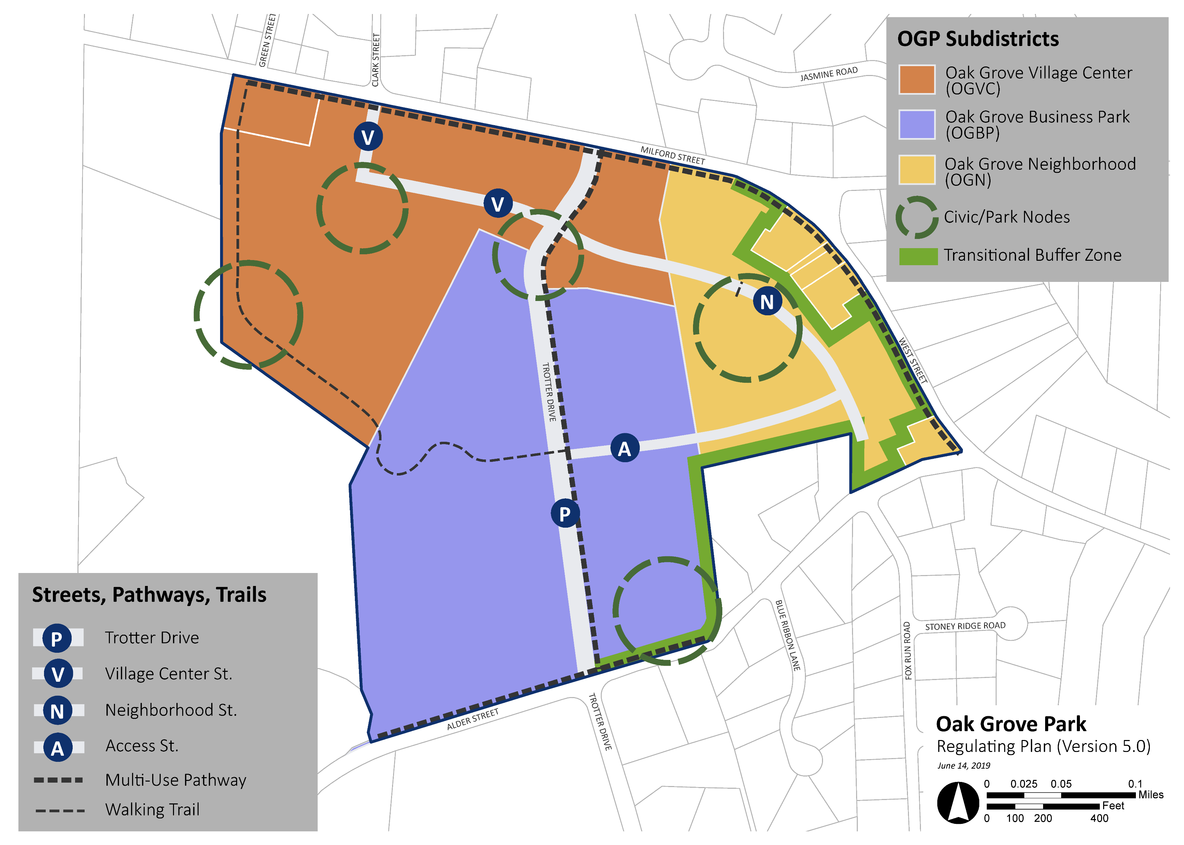
Example: Hickory Ridge Redevelopment, Amherst, MA & Oak Grove Park Mixed Use Form-Based Zoning Bylaw, Medway, MA
Highest and Best Use Study: An evaluation of the conditions, needs, and goals for a site to determine a use that is physically and financially feasible, community-supported, and results in the highest value (The Appraisal Institute)
1
2
3
Existing Conditions & Potential Use Analysis
Market Trends Analysis
Public Visioning & Scenario Building
Conservation, Development, Mobility, Highest and Best Use
Public Input & Evaluation of Best Use Alternatives
Final Plan for Selected Best Use Alternative

Slide 8
July
September
August
October
IRON RAIL BEST USE STUDY SCHEDULE
Project Kick-off
Advisory Group Meeting
Site analysis & assessment
Review of Town Plans, regulations, and market conditions
Stakeholder meetings
Synthesis of analysis & assessment and community input
Development of 3 Best Use Scenarios
Ongoing analysis & assessment
Stakeholder meetings
Public Meeting 1 – Shared fact-finding and goal-setting
Stakeholder Meetings
Public Meeting 2 - Review of 3 Best Use Scenarios
Additional testing and evaluation of scenarios by project team
Prepare final annotated plan

Slide 9
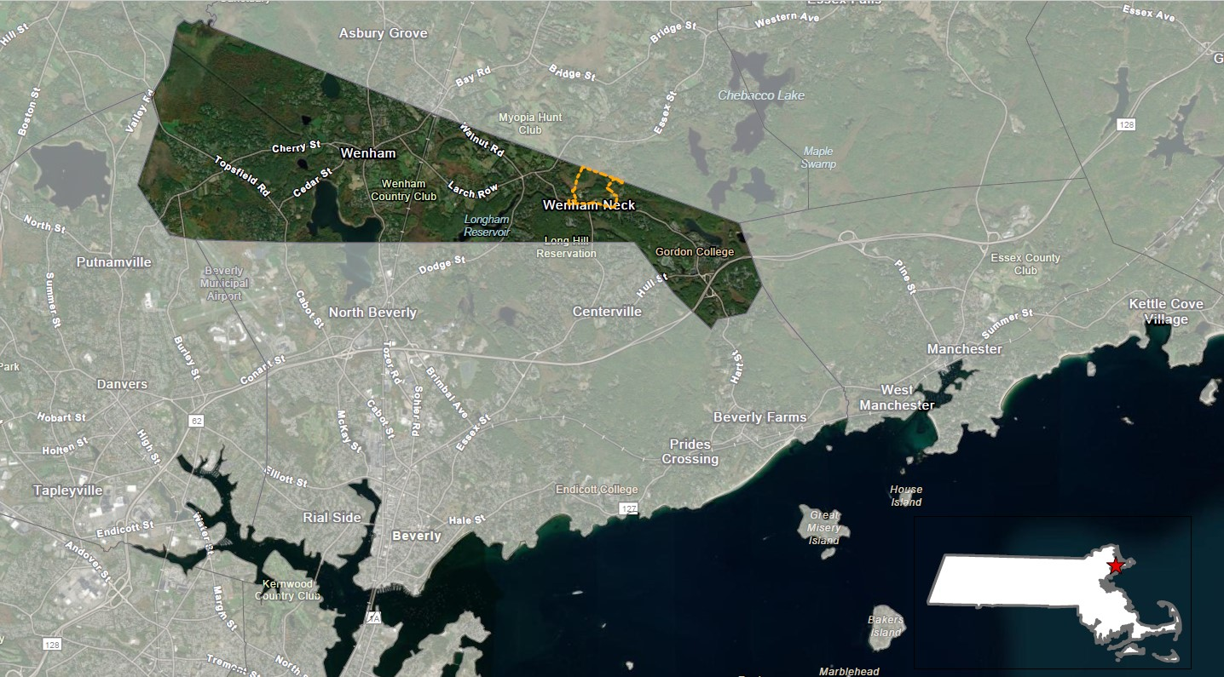
IRON RAIL PROPERTY CONTEXT
Iron Rail Project Area
(91 Grapevine Road)
Wenham Town Center
Site Information
79.5 acres in east Wenham, on the northern border with the Town of Hamilton
Residential Zoning
<3 miles to Town Center
Surrounding Context
<5 miles to the coast
<30 miles to Boston
<45 miles to Portsmouth, NH

Slide 10
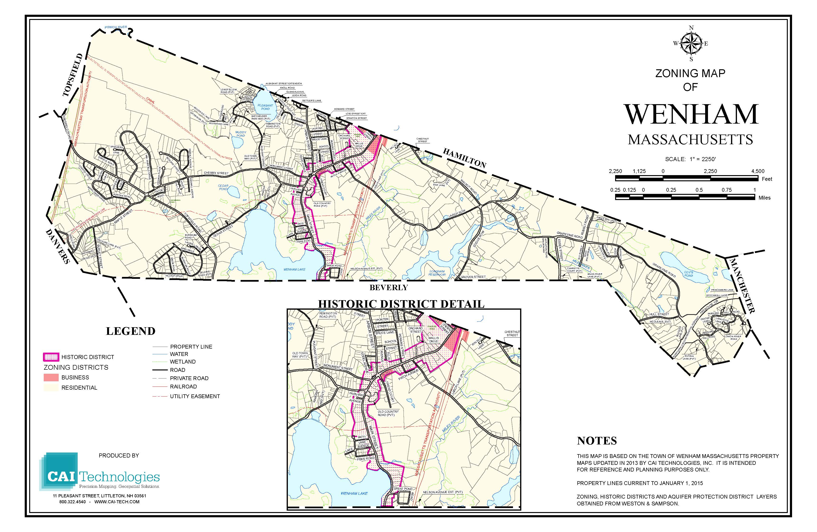
ZONING & DEVELOPMENT
99.7% zoned Residential
98% of property tax revenues come from residential properties
0.3% zoned Commercial
Mostly within the historic district
No commercial and industrial growth in the last 15 years
No large grocery store or pharmacy; few restaurants and other retail shops.
Small business base leads to “retail leakage”
99.7% Residential Zoning
(Wenham Master Plan Draft, 2022)

Slide 11
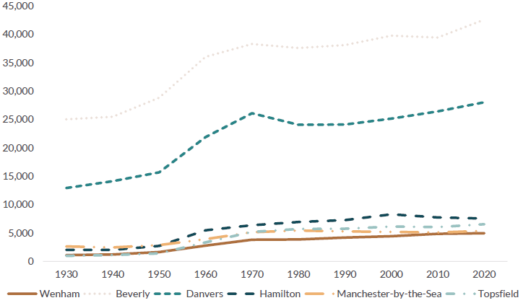
POPULATION TRENDS
Populations of Wenham and Neighboring Municipalities
Wenham Population (2021 ACS) = 5,006
Lowest among 6 neighboring communities
1,291 occupied housing units.
Steady growth in recent decades has slowed since 2010
27.8% between 1980 and 2020 (equal to Essex County and higher than Massachusetts)
However, growth slowed to 2% between 2010 and 2020
Nevertheless, people are moving to Wenham
In 2021, 11% of the population had moved to Wenham from a different county and 3.7% from a different state within the last year.
(US Census and UMass Donahue Institute)
(Master Plan Draft, 2022)
(ACS 5-Year Estimates, 2021)
(US Census and UMass Donahue Institute)

Slide 12
DEMOGRAPHICS
Wenham…
has many households with families.
is young:
Median age is 23.6, compared with 40.8 in Essex County and 39.6 in Massachusetts, which may be influenced by student residents of Gordon College.
is highly educated:
99% have graduated from high school and 69% have a bachelor’s degree or higher, compared with 90% and 41% for Essex County.
has a low poverty rate:
4.4%, compared with 9.9% for Essex County and Massachusetts
is affluent:
Median household income is high compared with the county and state; however, income is considerably lower for non-family households.
(ACS 5-Year Estimates, 2021; Master Plan Draft, 2022)
(ACS 5-Year Estimates, 2021)
Notes:
According to the Town Census, when the population living at Gordon College (1,266) is removed from the data, the population ages 18-34 shrinks by half.
Over one-third of students in 2023 are ethnically non-white or international (Gordon College, 2023)

Slide 13
HOUSING TRENDS
Wenham has a high rate of homeowners and a high median home value.
(ACS 5-Year Estimates, 2021)
(ACS 5-Year Estimates, 2021)
Homeowners earn nearly 3x as much as renters, and renters are cost-burdened at higher rates.
(Master Plan Draft, 2022, citing ACS 5-Year Estimates, 2020)
(ACS 5-Year Estimates, 2021)
Notes:
Wenham met the 10% affordable housing state quota in 2022, yet access to housing may remain difficult for lower income residents, especially families.
It should be noted that Wenham’s rates of cost-burdened households are high for both renters and home-owners.

Slide 14
HOUSING TRENDS
Homes in Wenham have been increasing in price and decreasing in availability.
Median sales prices have increased steadily since 2016, peaking in 2022, when 28 single-family properties and 8 condominiums sold.
Prices appear to be stabilizing in 2023.
Homes are not available in Wenham for under $300,000. Homes for less than $400,000 are becoming scarce.
While Wenham is meeting the state quota of 10% affordable housing, access remains difficult for lower income residents, especially families.
(ACS 5-Year Estimates, 2021)
(ACS 5-Year Estimates, 2021; Master Plan Draft, 2022)
(Massachusetts Association of Realtors)

Slide 15
COMMUTING AND TRANSPORTATION
Wenham residents tend to own more cars but commute less than the county.
Wenham
23.4 minute average commute
Essex County
29.6 minute average commute
(ACS 5-Year Estimates, 2021)
Wenham relies on cars for transportation.
The Hamilton/Wenham MBTA stop provides commuter access to Boston, but few other options for shopping and other needs.
Few bike lanes exist apart from the Rail Trail.
15% of streets have a MassDOT compliant sidewalk along one side.
(ACS 5-Year Estimates, 2021)
(Master Plan Draft, 2022)

Slide 16
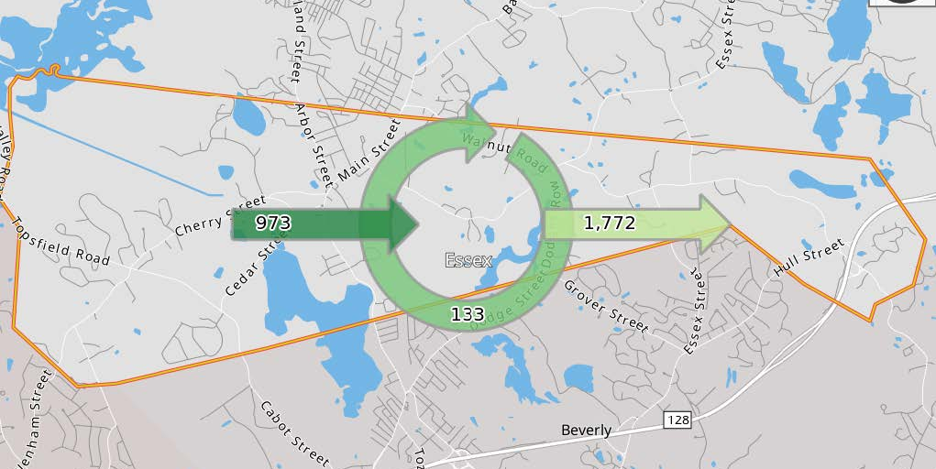
JOBS IN WENHAM
Wenham’s job market has one job for every four residents of working age.
93% of residents work outside of town; 133 residents work in town.
23% of residents work in Boston, 10% work in Beverly, and 19% work remotely from home.
Most jobs in Wenham are filled by workers commuting from other towns, including 12% from Beverly.
(Census On The Map, 2020)
Job inflow and outflow in Wenham (Census On The Map, 2020)

Slide 17
JOBS IN WENHAM
Wenham’s largest employers are tax-exempt educational institutions.
The 5 largest employers include:
The Academy at Penguin Hall
Civa (Christians in the Visual Arts
Burker Elementary School
Gordon College Board of Trustees
Hamilton-Wenham Regional School District
Nearly half of Wenham’s jobs pay $1,250 per month or less, and 37% are filled by workers under the age of 30.
Added the most jobs between 2011 and 2019
(Census On The Map, 2020)
(Massachusetts Department of Economic Research, 2022; Census On The Map, 2020)

Slide 18
FISCAL CONSIDERATIONS
Wenham maintains a balanced budget, but expenses have outpaced revenue in the recent past.
Wenham’s tax revenue exceeded expenditures by about $1M in 2021.
However, expenditures exceeded revenue in 2017 and 2019.
Public expenses are driven by education (50%) and public safety (20%).
Wenham’s tax base is almost entirely sourced from residential property.
However, at $19.58 per $1,000, Wenham’s residential property tax rate is the highest in the region.
Tax revenue from commercial and industrial property taxes account for 1% of the total tax levy.
Municipality | Commercial & Industrial Taxes as Percent of Total Levy (2022)
Wenham | 1%
Boxford | 1%
Hamilton | 3%
Topsfield | 6%
Essex | 7%
(Master Plan Draft, 2022, citing Wenham Annual Audits)
(Master Plan Draft, 2022, citing Massachusetts Executive Office of Labor and Workforce Development, Labor Market Information and Massachusetts Department of Revenue, Division of Local Services,
Community Comparison Report)

Slide 19
RELEVANT GOALS FROM THE MASTER PLAN DRAFT
Bolster resilience by increasing job diversity and tax base diversity.
Diversify the town’s job portfolio into other industries
Increase tax base diversity by developing commercial properties
Increase retail spending in Wenham and limit “leakage”
Prioritize, prepare for, and realize the potential for commercial development.
Rezone town-owned property for commercial or industrial use to attract new businesses and take advantage of the right economic development opportunity when it arises.
Consider ways to diversify housing stock in Wenham.
Increase options for affordable housing for seniors, families, and individuals with special needs.
(Wenham Master Plan Draft, 2022)

Slide 20
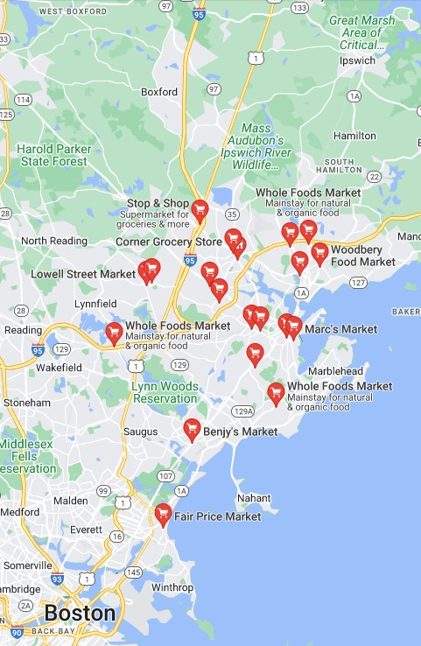
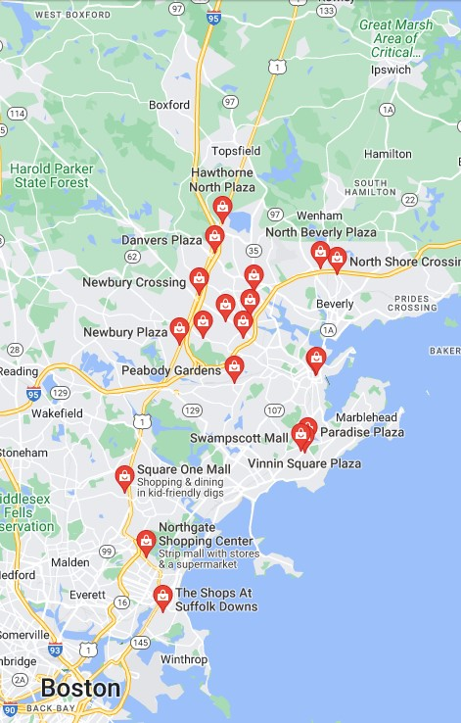
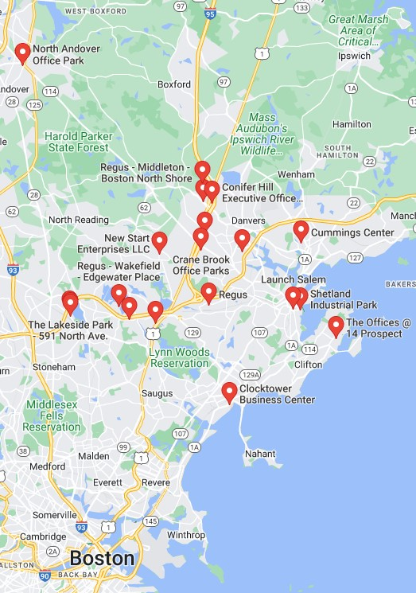
REGIONAL MARKET DEMAND
Iron Rail Property
Grocery Stores
Malls
Office Parks

Slide 21
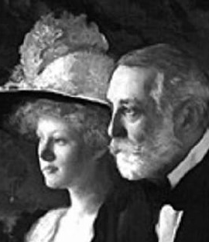
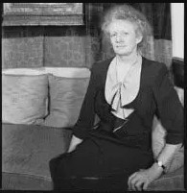
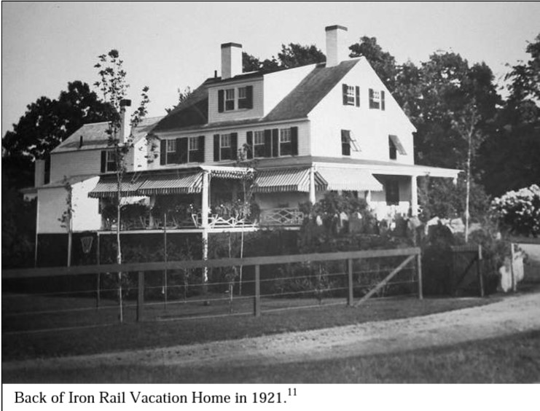
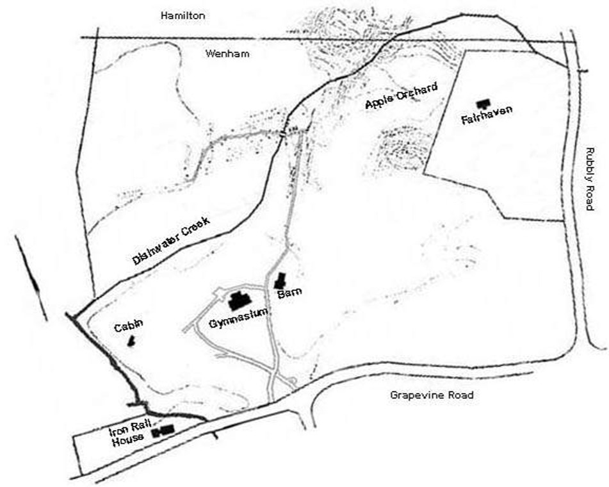
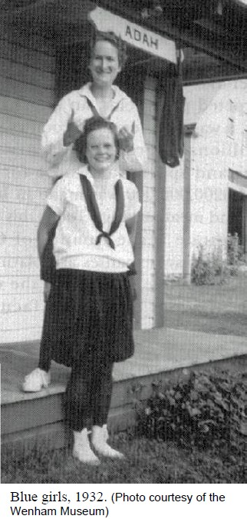
History of the Iron Rail Property
Source: Treasures Of Wenham History, Helen Frick and the True Blue Girls, Jack E. Hauck
1638
Land-grant to Richard Dodge.
1703
Iron Rail House built. The property got its name from the iron railings in front.
1850-1899
Used as a working farm.
1909
Bought by Henry Frick, steel industrialist, for his daughter Helen Clay Frick who, instead of accepting a pearl necklace as a gift from her father, asked to be given a place in the country where mill girls from the city could spend a vacation in the county.
Helen had originally welcomed 62 young women to Stillman Farm and Eagle Rock, her family’s estate in Beverly. After that, she quickly realized that she needed more space.
The life’s work of Helen Clay Frick was of making life more enjoyable for the mill girls of Lawrence, Lowell, and other New England cities, by providing them with a place for rest and respite during the summer.
With limited options for women outside of domestic life, mill work was an opportunity for women to be gainfully employed. Working-class girls at the time might begin working at fourteen years old and would work 70 hours a week for as little as $5.25/week.
The “Blue Girls” would travel by train from Boston to Beverly and by trolley from Beverly to Wenham.
Helen Frick lived to the age of 96. She said that of all the things in her life, her “greatest interest” was the Iron Rail.

Slide 22
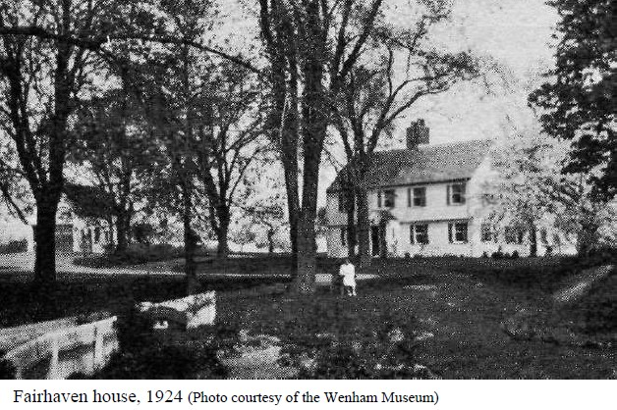
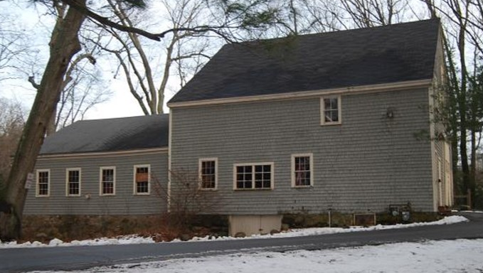
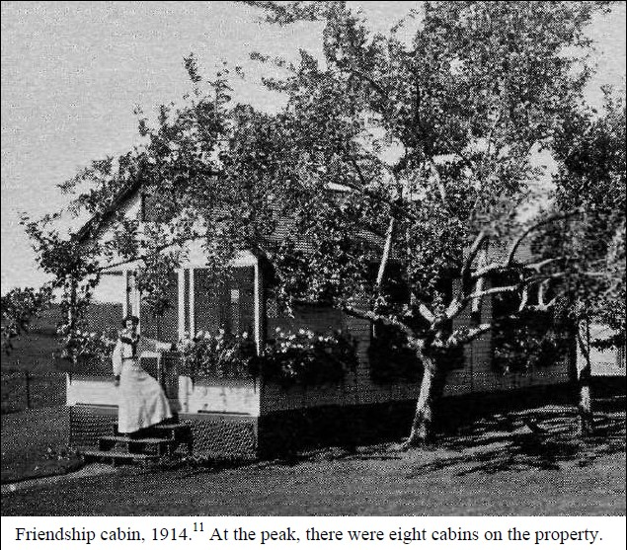
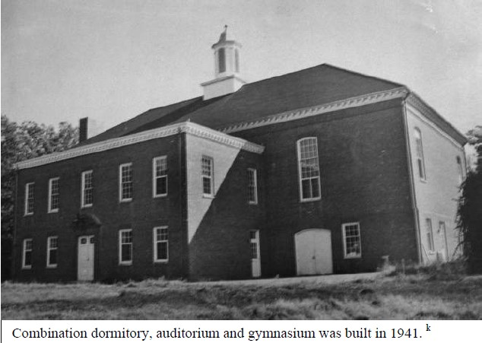
History of the Iron Rail Property
Source: Treasures Of Wenham History, Helen Frick and the True Blue Girls, Jack E. Hauck
1976
Iron Rail house was moved to Hamilton.
2017
the Iron Rail Property was recommended for listing in the National Register of Historic Places for its significance in the early 20th century progressive movement.
1910
Nearly five hundred guests came to the Iron Rail Vacation Home the first summer. Over time, 10 additional cabins were built to accommodate guests.
1920
Helen built Fairhaven for Ellen Boyd, an experienced social worker from Boston, who lived there and directed the camp for 30 years.
1941
The brick auditorium and gymnasium was built, equipped with a large kitchen, dormitory, additional rooms and a library.
1953
44 years of Iron Rail vacations came to an end with appx. 32,670 vacations, and 20,000 mill girls in all.
1954
the property was transferred to the Girls’ Clubs of America and the property was used as a summer camp.

Slide 23
IRON RAIL COMMISSION
5 Members
Mission:
To maintain, repair and protect the property.
To aggressively plan for rental, gymnasium and meadow use in order to create income, revitalize the land and encourage active use of the area for educational enjoyment by all townspeople.
To work with other town groups in arranging for the orderly use of the land.
(Wenham Town website, 2023)

Slide 24
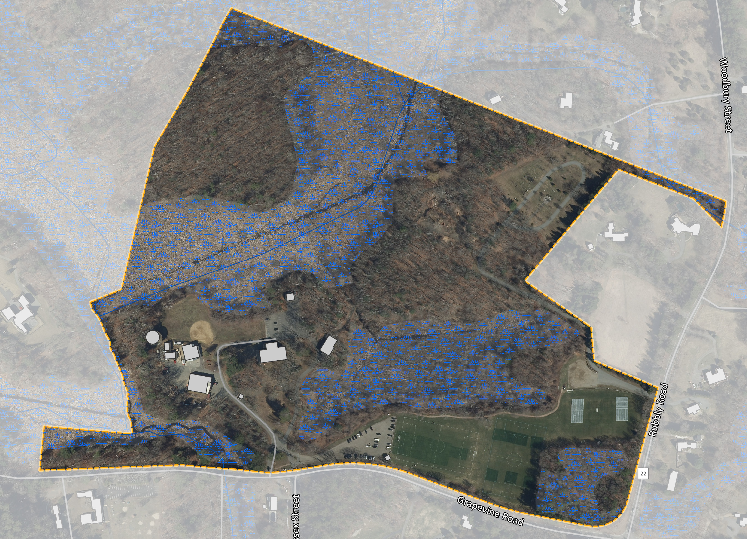
EXISTING CONDITIONS
79.5 acres total
Town-owned
Department of Public Works headquarters and main garage
The Water Department water storage facility
No sewer services
Cemetery
Iron Rail Building & tenants
Boy Scout Barn
Baseball field
3 soccer fields
3 parking lots
In total, property generates about $150,000 in revenues annually.
Iron Rail Cemetery
Baseball Field
Two car garage
Water Tower
Parking lot
Boy Scout Barn
Parking lot
Iron Rail Building
Wenham Highway Department
Soccer Fields
Parking lot

Slide 25
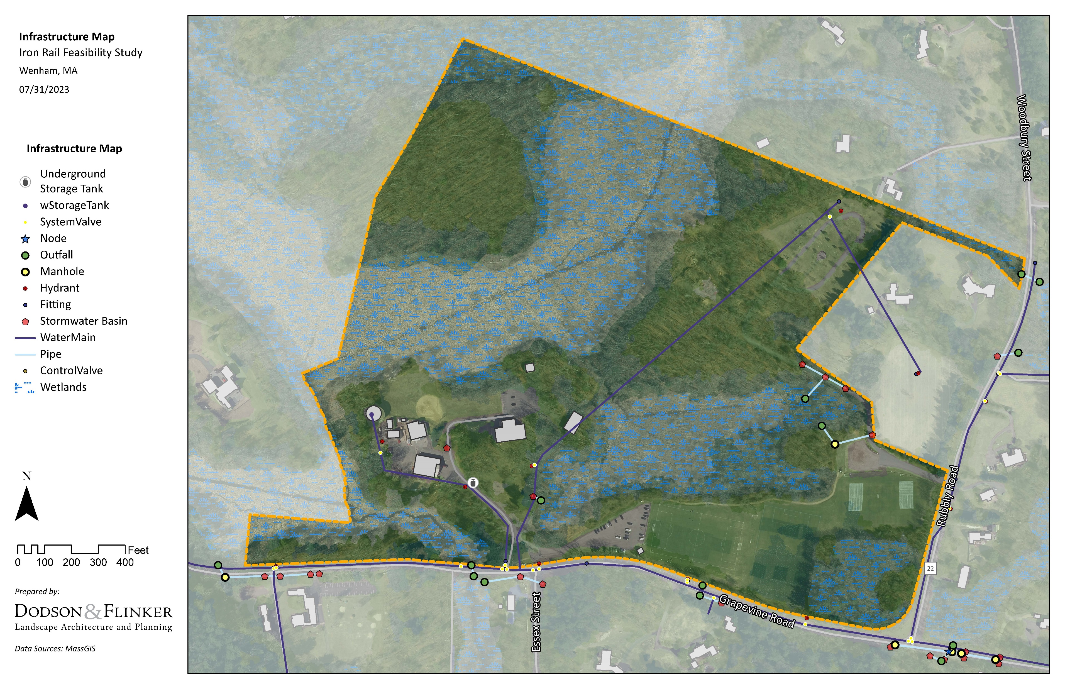
INFRASTRUCTURE

Slide 26
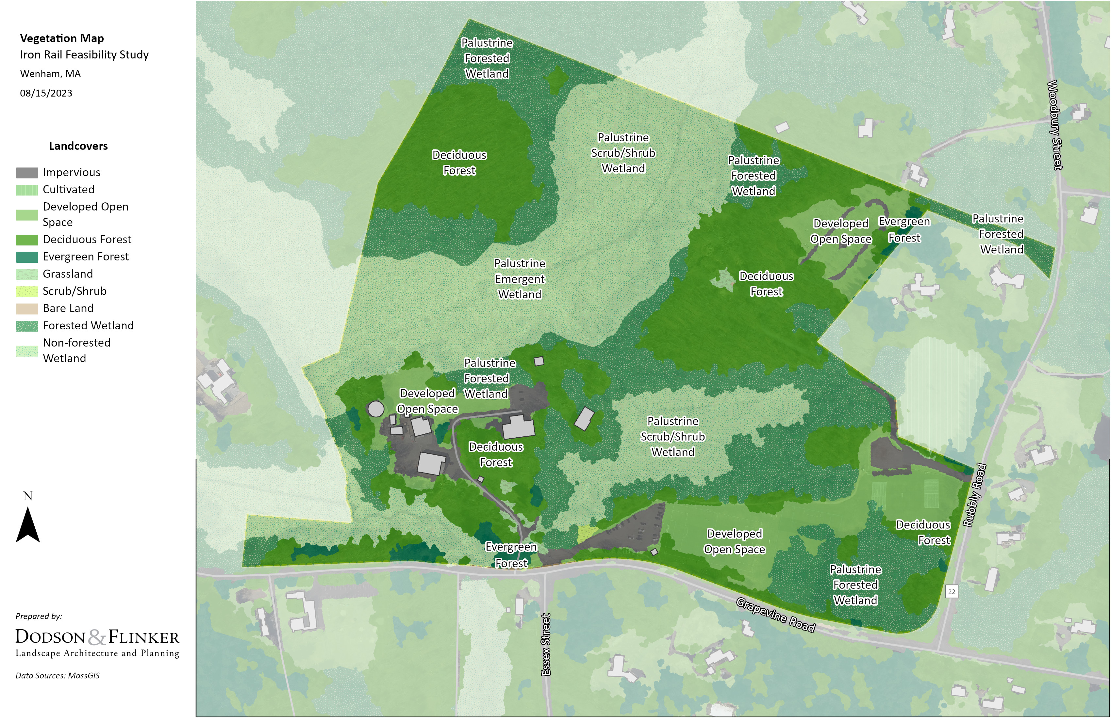
VEGETATION

Slide 27
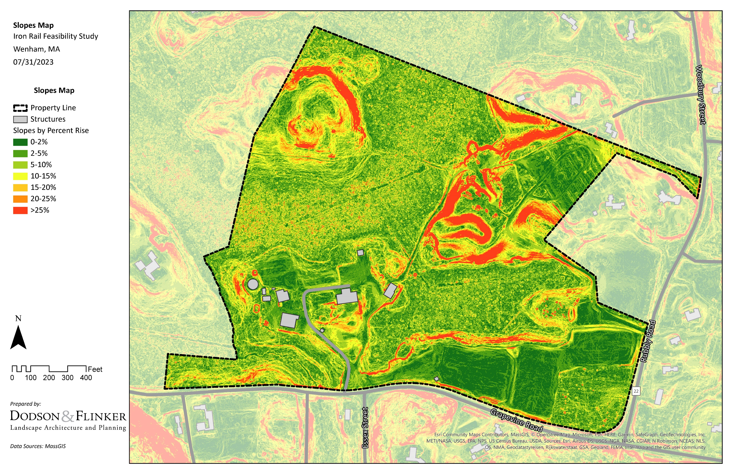
SLOPES

Slide 28
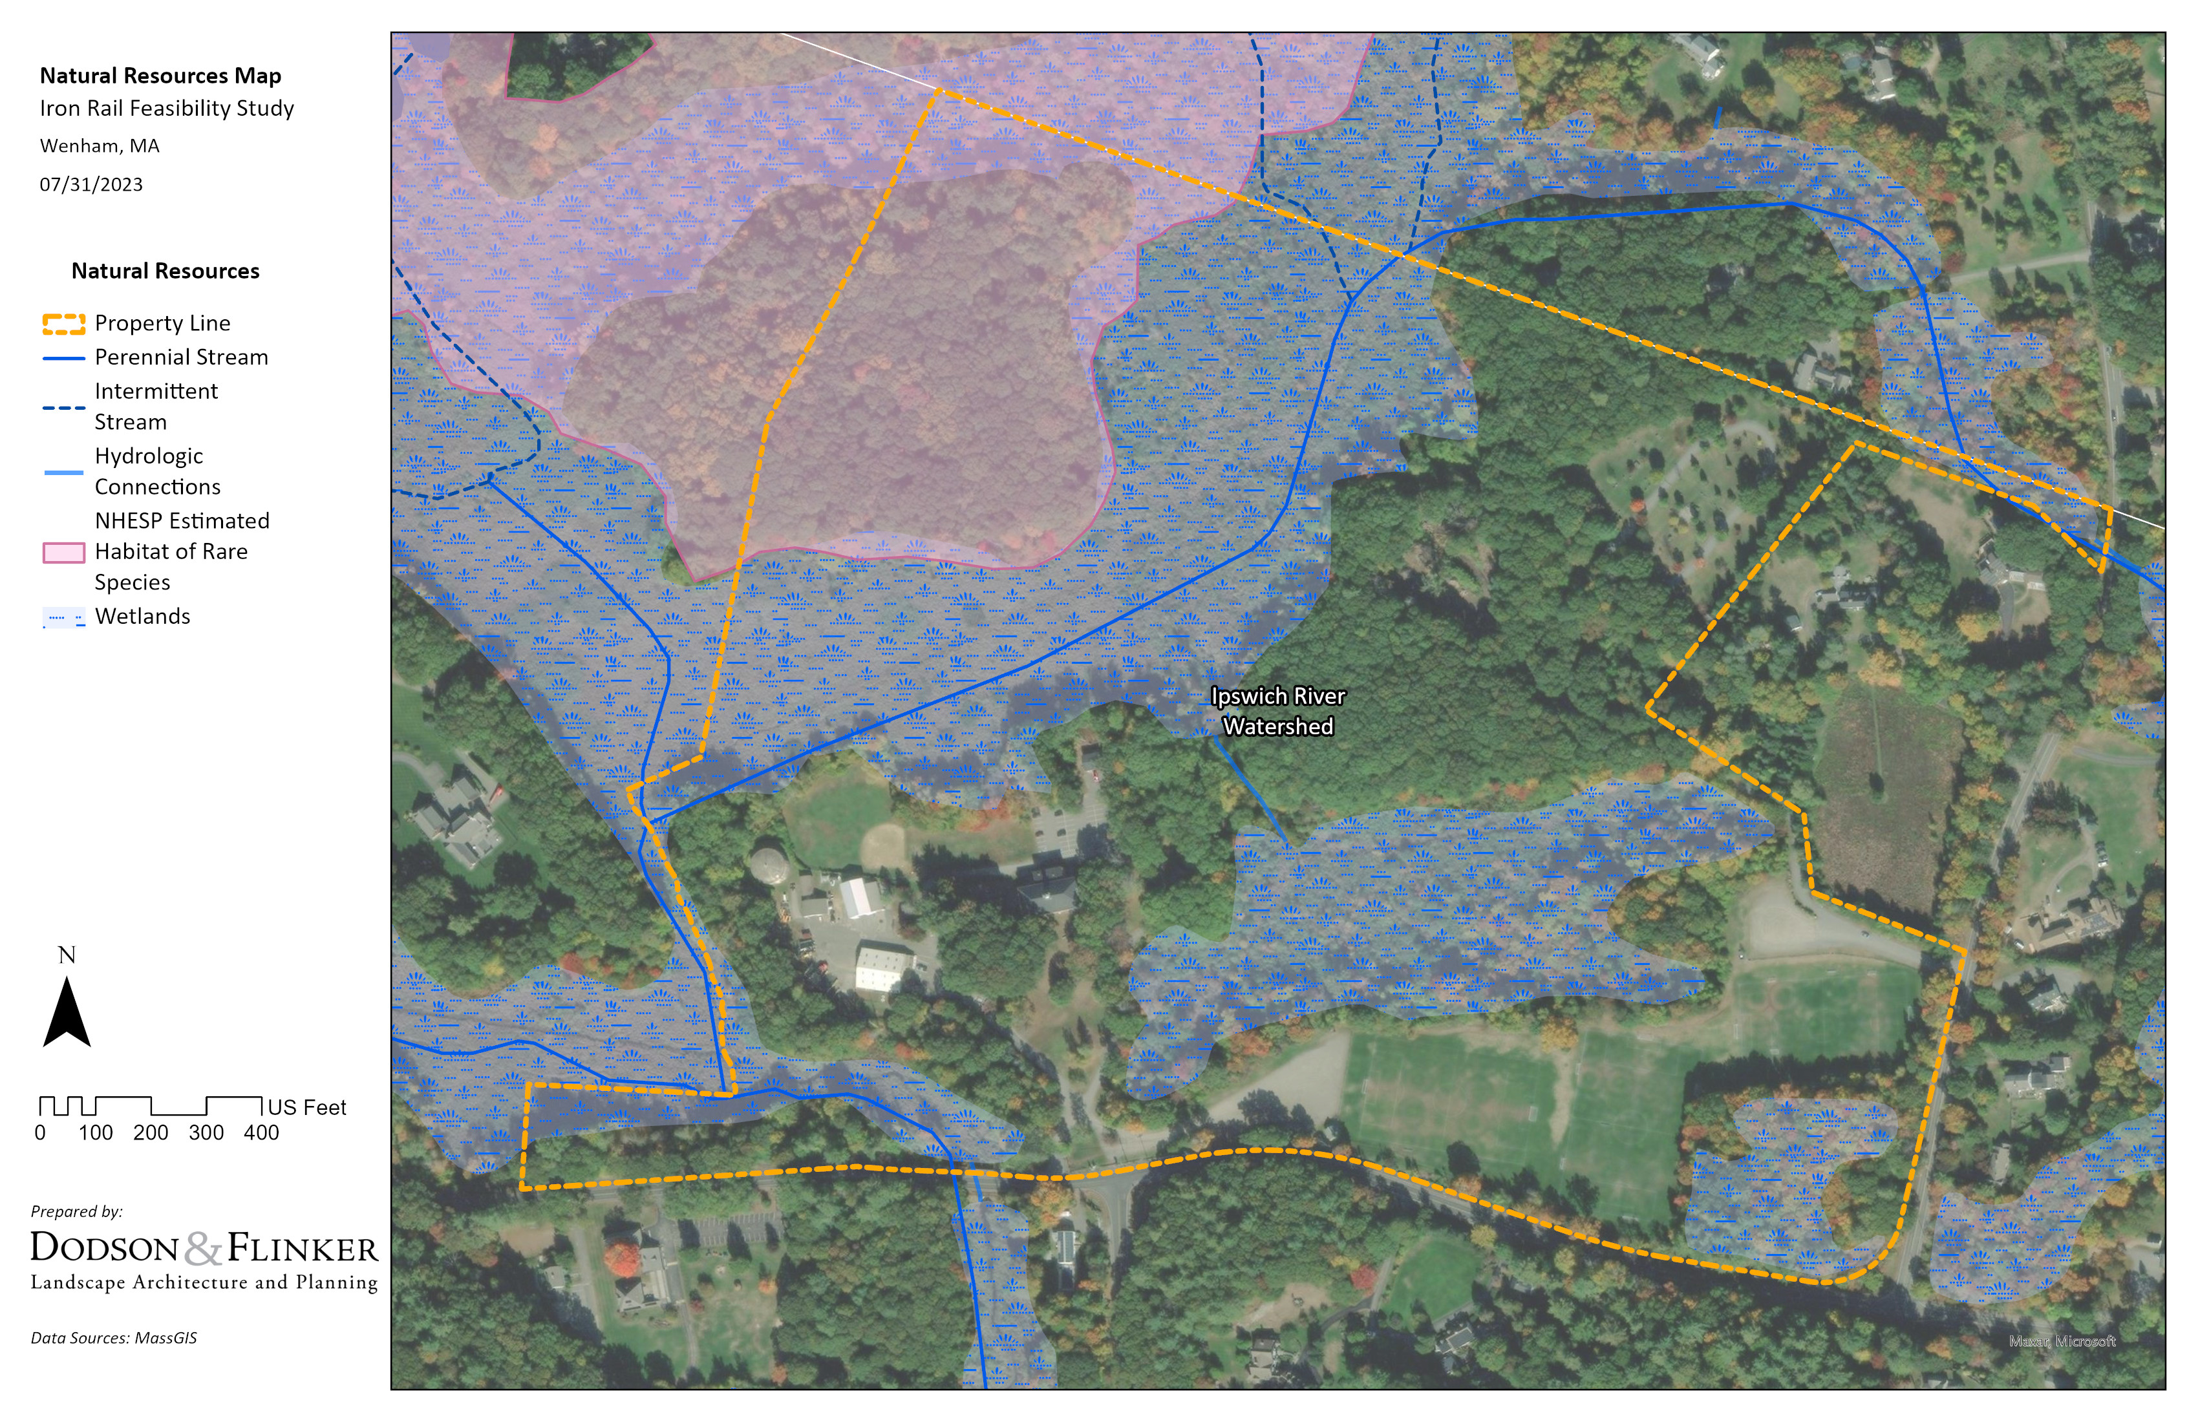
NATURAL RESOURCES

Slide 29
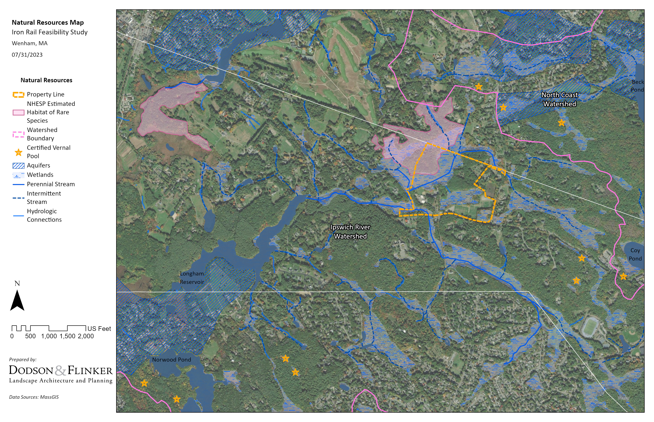
NATURAL RESOURCES

Slide 30
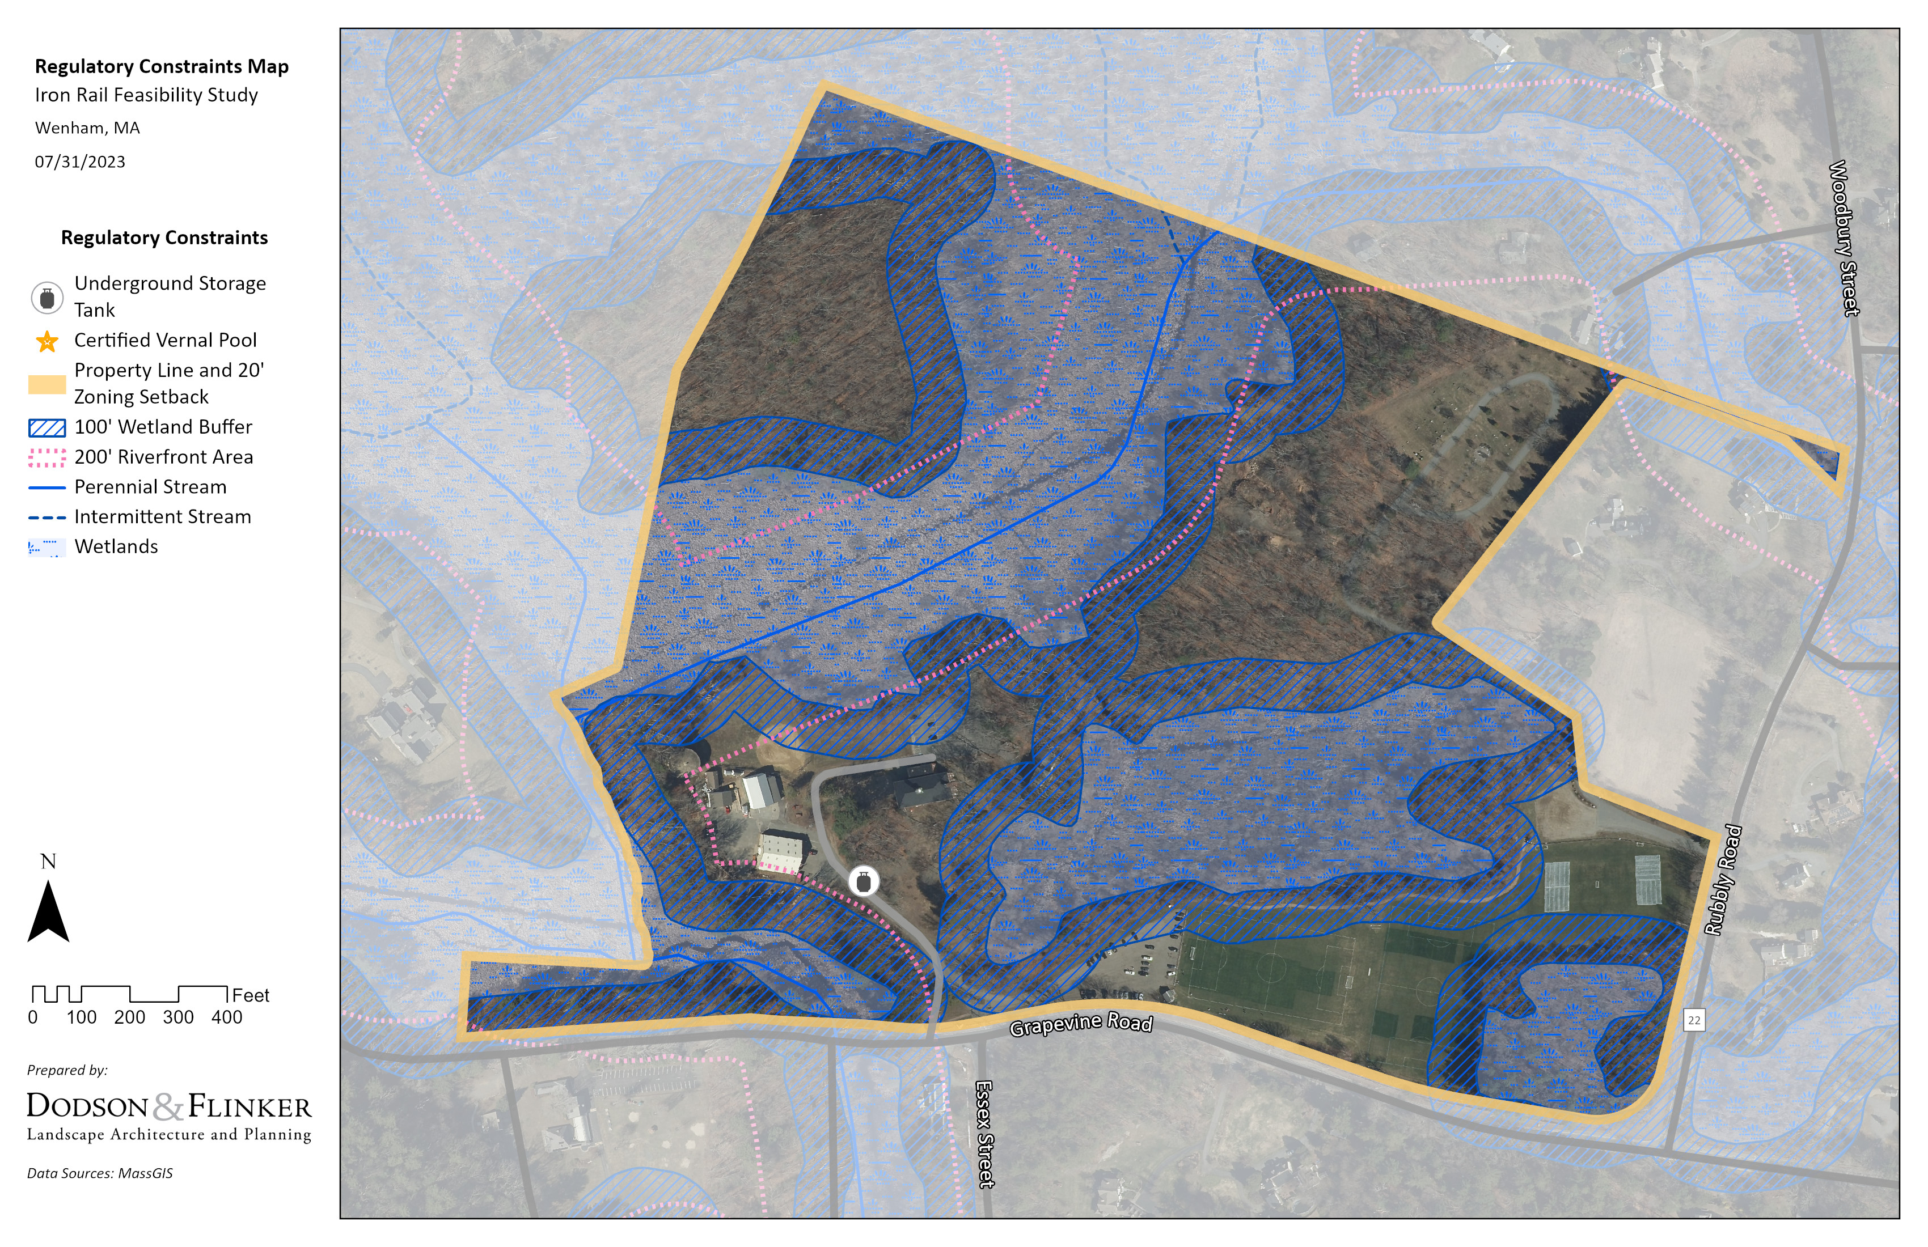
REGULATORY CONSTRAINTS
Wetlands 23.4% 18.6 acres

Slide 31
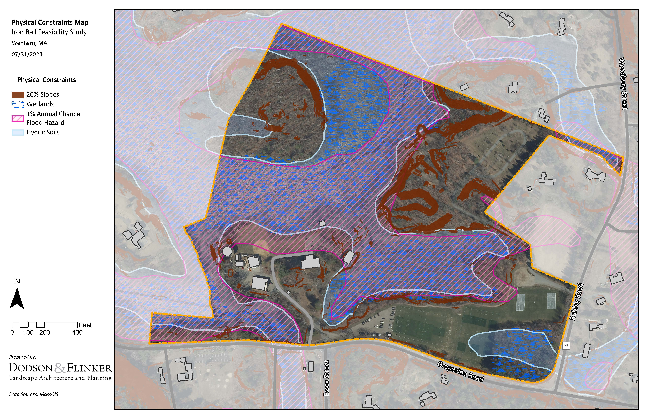
PHYSICAL CONSTRAINTS
Apx. 6.55 acres adjacent to cemetery contains steep slopes
Apx. 4.26 acres no access roads, steep slopes and hydric soils
Apx. 4.11 acres contains DPW, historic building with active local business tenants
Apx. 6.3 acres with active soccer fields

Slide 32
BRAINSTORM!

Slide 33
Tell us what you know. Zoom attendees please respond using chat. Raise your hand if you want to speak.
Question 1:
What strengths, challenges, and future opportunities do you think are most important?

Slide 34
Tell us what you know. Zoom attendees please respond using chat. Raise your hand if you want to speak.
Question 2:
What else should we know to make good decisions about the site and potential future uses?

Slide 35
Tell us what you know. Zoom attendees please respond using chat. Raise your hand if you want to speak.
Question 3:
What community needs and goals could the Iron Rail Property help with?

Slide 36
Tell us what you know. Zoom attendees please respond using chat. Raise your hand if you want to speak.
Question 4:
What future uses and programming should be explored?

Slide 37
THANK YOU!
Contact
Information:
Peter Flinker, FAICP, FASLA
Dodson & Flinker
peter@dodsonflinker.com
413-628-4496 x 102
Helena Farrell, MLA
Dodson & Flinker
helena@dodsonflinker.com
413-628-4496 x 107

